Slide 1
MedWise Personal Health Assistant
A project by Cookie Army

Slide 2
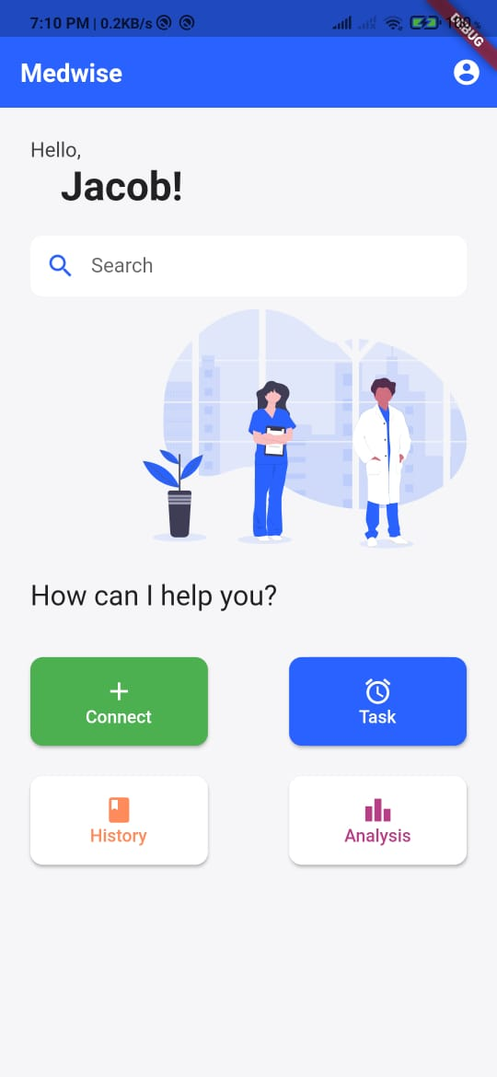
What is MedWise?
A mobile app that connects doctors and patients through a secure platform
Connect with doctors nearby.
Consult doctors using chat, call or video call.
Pay according to the mode of consultation.
Other features like task reminders, analysis, medical history etc.. More on that in the coming slides

Slide 3
Why MedWise?
People preferring to get treatment from home, relying on home remedies.
Physical presence of patients at health center's and hospitals is not an option these days because of fear of getting infected by COVID 19.
People are trying their level best to get their medication done from their homes.
Often they rely on home remedies even for some serious ailments which actually needs the consultation of a doctor.
Through the medwise app, patients can consult with doctors and decide what is their best course of treatment.

Slide 4
Why MedWise?
Makes treatment and follow ups more efficient
Busy with work? No time to attend follow up sessions at the hospital?
Why not consult doctors from your home using the medwise app.
How can doctors treat you if they don't have your hospital files or prescriptions, you might wonder..
Medwise app has a feature of securely storing your medical history, prescriptions, test results etc.

Slide 5
Why MedWise?
Plan your daily routine
Using the to-do list feature, set tasks and reminders
Both patients and doctors can analyze task completion data, having graphs and numbers for each category - medicine, exercise, diet etc.
Doctors can monitor their patients progress
For diet control, Rehab from injuries and surgeries etc.
Having analysis feature will help in the monitoring process

Slide 6
Why MedWise?
What’s in it for the doctors?
Doctors can set their own rates for each mode of consultation - chat, call or video call.
Reduce the number of hours spent at hospitals

Slide 7
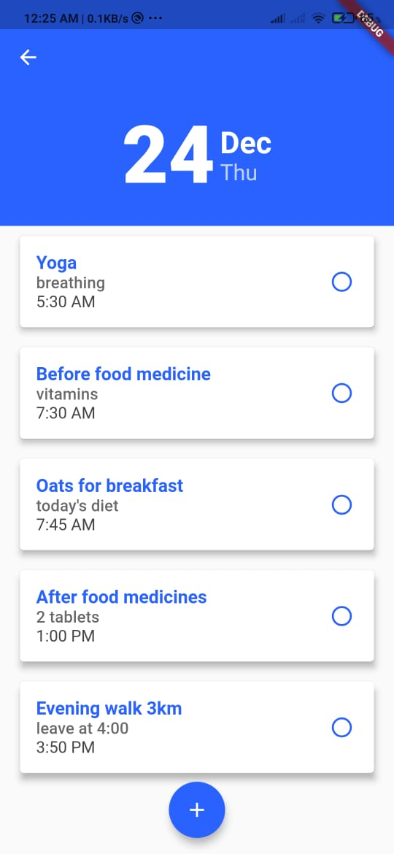
Features
To-dos list feature in the app, which has the patients routine planned either by the doctor or by the patient himself.
Receive task reminders on time

Slide 8
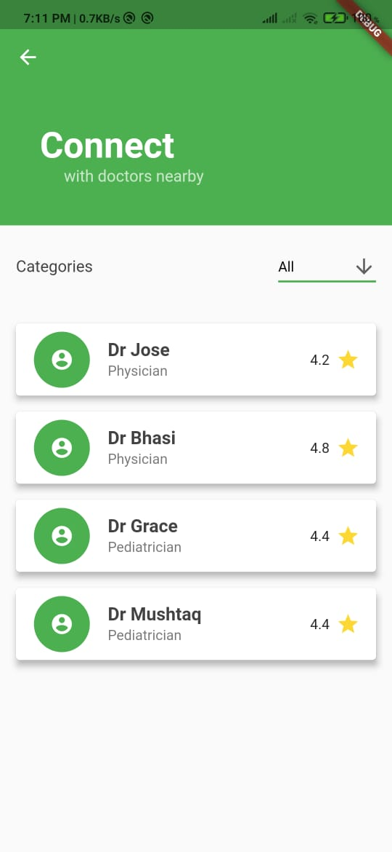
Features
Filter doctors on the basis of specialization, rating and reviews.
Patients with several health issues can maintain contact with doctors of different specialisations using a single app.
Consultation using chat, call or video call facilities.

Slide 9
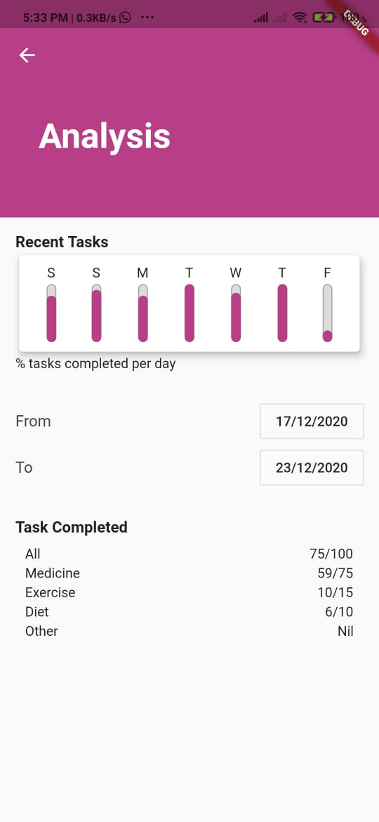
Features
Analysis page – of task completion data
Securely store medical history of patients, including prescriptions and test results

Slide 10

Demo

Slide 11


